Slide 1




Debt Consolidation | Home Renovation/Furnishing | Medical Expenses | Family Vacations | Business Funding
Special rate for Permanent Employees
of
https://www.aeoncredit.com.my/aeon-staff
6%p.a.
Up to
RM 100K*
5 years
maximum
repayment
tenure
RM 52
minimum
monthly
repayment
Processing
Fee
Waived
Effective from,
17 May 2017

Slide 2
Contents
Product Features
Web Submission Steps
Documents Required
Promotion Code
Instalment Tables
Signing of Agreement
Panel Banks for Auto-Debit Facility
Payment Channels & Charges
Frequently Asked Questions (FAQs)
Appendix A – Standard Verification of Permanent Employment Letter Template
Appendix B - Sample completed by HR the Verification of Permanent Employment Letter
1
2
3
4
5
6
7
8
9
10
11

Slide 3
Product Features
Item | Permanent Employees
Finance Amount | RM1,000 – RM100,000
Profit Rates | 0.50 % per month, or
 | 6.0 % per annum
Tenure | 6 – 60 months
Processing Fee | Waived
Stamp Duty | 0.50% of the approved financing amount
Repayment Mode | Auto-debit from salary account

Slide 4
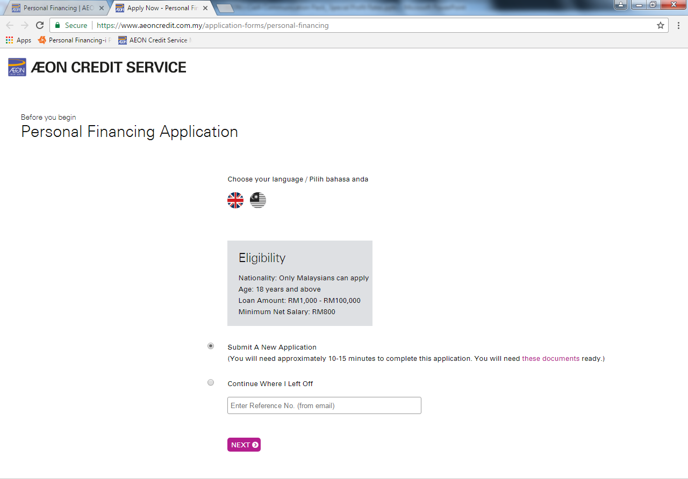
Web Submission Steps (1/3)
IMPORTANT :
Application are required to submit through AEON Credit Service website channel (e-application) https://www.aeoncredit.com.my/aeon-staff with COMPLETE supporting documents. Click the button to apply.

Slide 5

Web Submission Steps (2/3)
Click the Apply Button available at the following URL https://www.aeoncredit.com.my/aeon-staff
1
5
Choose preferred language & Select ‘Submit A New Application’ & Click Next
Are you under the permanent employment of AEON Group of Companies : Select ‘Yes’
2
Enter Name & Contact Details
6
Permanent Staff
Company Name : Select from drop down list
3
7
Enter Personal Details
Input Promotion Code : Staff to obtain from HR Dept
4
Employment Type : Select Employed

Slide 6
Web Submission Steps (3/3)
8
Continue input Employment details & Income
9
Summary Page of Application
Emergency Contact
13
Declaration : Consent of PDPA, Promotional terms
10
Details of financing
14
Click Submit Application
11
Input Loan Account Information
Ref. No will be provided, a confirmation email will be sent to the applicant
12
Upload Documents : Mandatory documents are NRIC, EPF Statement, Verification of Permanent Employment Letter
Application is routed to Credit Assessment Dept
End

Slide 7
Documents Required
Verification of Permanent Employment Letter
EPF
Statement
Latest 3 Months Pay Slips
NRIC
+
+
+
or
Bank Statement Salary Crediting

Slide 8

Promotion Code
AEONPF01
IMPORTANT
The correct Promotion Code must be entered correctly in the e-Submission to be entitled for the special rate.
The system will not allow the staff to proceed with the next steps if wrong promotion code is entered.

Slide 9
Installment Table (1/2)
Financing Amount ≤ RM10,000 (RM 1,000 – RM 10,000)
Financing Amount (RM) | Tenure/ Instalment Period (Month)
 | 6 | 9 | 12 | 15 | 18 | 24 | 30 | 36 | 48 | 60
1,000 | 172 | 116 | 88 | 72 | 61
2,000 | 343 | 232 | 177 | 143 | 121 | 93 | 77 | 66 | 52
3,000 | 515 | 348 | 265 | 215 | 182 | 140 | 115 | 98 | 78 | 65
4,000 | 687 | 464 | 353 | 287 | 242 | 187 | 153 | 131 | 103 | 87
5,000 | 858 | 581 | 442 | 358 | 303 | 233 | 192 | 164 | 129 | 108
6,000 | 1,030 | 697 | 530 | 430 | 363 | 280 | 230 | 197 | 155 | 130
7,000 | 1,202 | 813 | 618 | 502 | 424 | 327 | 268 | 229 | 181 | 152
8,000 | 1,373 | 929 | 707 | 573 | 484 | 373 | 307 | 262 | 207 | 173
9,000 | 1,545 | 1,045 | 795 | 645 | 545 | 420 | 345 | 295 | 233 | 195
10,000 | 1,717 | 1,161 | 883 | 717 | 606 | 467 | 383 | 328 | 258 | 217

Slide 10
Installment Table (2/2)
Financing Amount Below > RM10,000 (RM 10,001 – RM 100,000)
Financing Amount (RM) | Tenure/ Instalment Period (Month)
 | 6 | 9 | 12 | 15 | 18 | 24 | 30 | 36 | 48 | 60
20,000 | 3,433 | 2,322 | 1,767 | 1,433 | 1,211 | 933 | 767 | 656 | 517 | 433
30,000 | 5,150 | 3,483 | 2,650 | 2,150 | 1,817 | 1,400 | 1,150 | 983 | 775 | 650
40,000 | 6,867 | 4,644 | 3,533 | 2,867 | 2,422 | 1,867 | 1,533 | 1,311 | 1,033 | 867
50,000 | 8,583 | 5,806 | 4,417 | 3,583 | 3,028 | 2,333 | 1,917 | 1,639 | 1,292 | 1,083
60,000 | 10,300 | 6,967 | 5,300 | 4,300 | 3,633 | 2,800 | 2,300 | 1,967 | 1,550 | 1,300
70,000 | 12,017 | 8,128 | 6,183 | 5,017 | 4,239 | 3,267 | 2,683 | 2,294 | 1,808 | 1,517
80,000 | 13,733 | 9,289 | 7,067 | 5,733 | 4,844 | 3,733 | 3,067 | 2,622 | 2,067 | 1,733
90,000 | 15,450 | 10,450 | 7,950 | 6,450 | 5,450 | 4,200 | 3,450 | 2,950 | 2,325 | 1,950
100,000 | 17,167 | 11,611 | 8,833 | 7,167 | 6,056 | 4,667 | 3,833 | 3,278 | 2,583 | 2,167

Slide 11
Signing of Agreement
1
Walk-in to any of the nearest ACS branches
2
Perform original NRIC & fill up Auto-Debit Form to submit together with copy of Salary Account
Permanent Staff
3
Signing Sale & Purchase Agreement & Auto-Debit Form
4
Disbursed Option:
Credit into CASA account
Credit into Prepaid Card

Slide 12
Panel Banks For Auto-Debit Facility
Compulsory for each Personal Financing Customer to submit signed Auto
Debit Form (from salary account) upon signing Sale & Purchase (“S&P”)
Agreement.
ACSM’s Listed Panel Banks for Auto-Debit Facility
Maybank | AmBank
CIMB Bank | BSN
CIMB Islamic Bank | RHB Bank
Public Bank | Standard Chartered Bank
Alliance Bank | Bank Muamalat
For any customers who salary account is not from the listed bank above, the customer will be required to open any Current or Savings Account (CASA) at any of the ACSM’s panel bank.

Slide 13
Payment Channels and Charges
 | Payment Charges (RM)
Payment Channel | Maybank | CIMB Bank | CIMB Islamic Bank | Public Bank | Alliance Bank | AmBank | BSN | RHB Bank | Standard Chatered Bank | Bank Muamalat
Auto-Debit (Successful) | 0.53** | 1.06* | 1.06* | 0.53** | 0.64** | 1.06** | 1.06** | 1.06* | 0.53** | 0.53*
Auto-Debit (Unsuccessful) |  |  |  |  |  |  |  | 1.06*
Counter |  |  |  |  |  |  | 1.06**
Cash Deposit Machine | 1.59** | 1.06** | 1.06** | 1.06** | 0.53**
Cheque Deposit Terminal |  |  |  | 1.06** | 0.53**
ATM Transfer |  | 1.06* | 1.06* | 1.06* | 0.53** | 0.53** | 1.06**
Internet Banking | 1.06* | 0.64* | 0.64* | 1.06* |  | 0.53** | 1.06**
Interbank GIRO (IBG) | RM 0.11 via internet, RM 0.53 - RM 2.12 via Counter *. For full listing of all IBG participating banks, please refer www.myclear.org.my
Instant Transfer | RM 0.53*. For full listing of all IBG participating banks, please refer www.myclear.org.my
Note: The charges listed above are inclusive of 6% Goods & Services Tax (GST).
** Payment Charges will be deducted from customer’s Current Account or Savings Account
* Payment Charges need to be added in the payment amount.

Slide 14
Frequently Asked Questions (FAQ)
 | Questions / Answers
Q1. | What is this scheme about?
A1. | This is a special personal financing scheme offering profit rate of 0.5% per month (or 6% per year) to the permanent employees of AEON BiG (M) Sdn. Bhd.
Q2. | Who is eligible to apply for this scheme?
A2. | This scheme is only for PERMANENT EMPLOYEES of AEON BiG (M) Sdn Bhd.
Q3. | Where can I apply for this scheme?
A3. | You can only apply via web channel from this URL : https://www.aeoncredit.com.my/aeon-staff

Slide 15
Frequently Asked Questions (FAQ)
 | Questions / Answers
Q4. | What if I submit my application via other channels other than web?
A4. | Unfortunately at this point of time, only web channel will entitle you for the special profit rates. If you apply via other channels, your applications will be processed using normal commercial rates of between 0.8% - 1.5% per month or 9.6% - 18% per year.
Q5. | Can I request for change of profit rate after application is approved?
A5. | Profit rate is not allowed to be changed once the application is approved.
Q6. | Can a contract staff apply for this scheme?
A6. | This scheme is ONLY open to permanent staff. However, a contract staff still can apply subject to credit assessment with normal rates of between 0.8% - 1.5% per month or 9.6% - 18% per year.

Slide 16
Frequently Asked Questions (FAQ)
 | Questions / Answers
Q7. | What are the mandatory information to be submitted to entitle for the special rate?
A7. | Other than the mandatory details as specified in the web e-form, you MUST comply to the other TWO (2) additional MANDATORY requirement : (1) Ensure only the given Promotion Code is entered (2) Scan and upload your standard format of Verification of Permanent Employment Letter (To be printed on the Company Letterhead, to be signed and stamped by HR) Appendix A : Standard Verification of Permanent Employment Letter Template Appendix B : Sample completed Verification of Permanent Employment Letter.

Slide 17
Frequently Asked Questions (FAQ)
 | Questions / Answers
Q8. | What is the Promotion Code to be entered in the web application page?
A8. | The Promotion Code is AEONPF01
Q9. | Is there any additional terms and conditions for this special rate scheme?
A9. | AEON Credit Personal Financing comes with standard terms and conditions which is available in AEON Credit website. You are advised to read and understand the standard Terms and Conditions prior to submitting your application. There will also be a standard set of Terms and Conditions in the Sales & Purchase (S&P) Agreement which will be printed when you visit any of our branch to sign the S&P.

Slide 18
Frequently Asked Questions (FAQ)
 | Questions / Answers
Q10. | Is there any additional Product Disclosure Sheet for this special rate scheme?
A10. | AEON Credit Personal Financing comes with standard Product Disclosure Sheet which is available in AEON Credit website. You are advised to read and understand the standard Product Disclosure Sheet prior to submitting your application. There will also be a standard set of Product Disclosure Sheet produced when you visit any of our branch to sign the Sales & Purchase Agreement.
Q11. | How would I know whether my application is approved with the Special Profit Rate?
A11. | The profit rates will be informed to you in two (2) ways: (a) It will be printed in the final Product Disclosure Sheet produced upon signing of Sales & Purchase Agreement. (b) You will also received the Personal Financing Notification Letter which has the profit rate printed.

Slide 19
Frequently Asked Questions (FAQ)
 | Questions / Answers
Q12. | How would I know my monthly repayment amount (instalment amount)?
A12. | The monthly repayment amount (instalment amount) will be made available to you in two (2) ways: (a) It will be printed in the final Product Disclosure Sheet produced upon signing of Sales & Purchase Agreement. (b) You will also received the Personal Financing Notification Letter which has the monthly repayment amount indicated.
Q13. | If my application is rejected, will I be notified of the reason?
A13. | If the application is rejected, SMS notification will be sent to your mobile number registered with us. However, the reason of rejection will not be disclosed to anyone.

Slide 20
Frequently Asked Questions (FAQ)
 | Questions / Answers
Q14. | I apply for RM 100,000 financing. Will my application be approved with the same amount?
A14. | The final approved amount may not be the same as the applied amount, as each application is still subject to credit assessment.
Q15. | If the final finance amount is not as I have anticipated, can I choose not to accept the financing? If yes, how do I do that?
A15. | For every approved application, a Short Message Service (SMS) will be sent to the Staff to advise him/her to sign the Sales & Purchase Agreement at the nearest AEON Credit Service branch. Should the staff decided not to accept the financing, the staff may contact our Customer Service Department at 03-27199999 for cancellation request.

Slide 21
Frequently Asked Questions (FAQ)
 | Questions / Answers
Q16. | Is there any dedicated line/number to contact for any matters related to this Special Scheme?
A16. | There is no dedicated number to be contacted for this scheme. However, the Staff can contact AEON Credit Service Customer Service general line at 03-27199999 for matter related to this scheme.

Slide 22
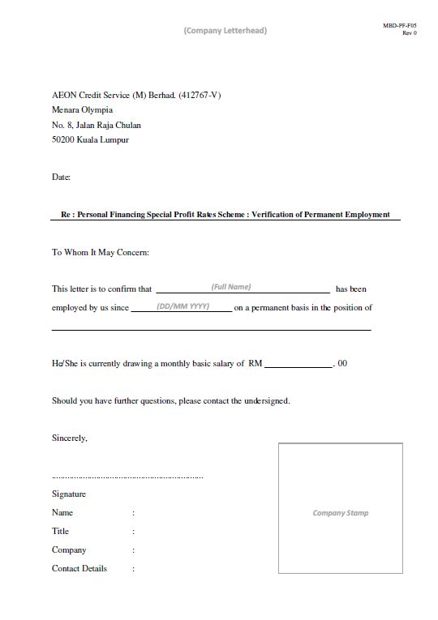
Appendix A : Standard Verification of Permanent Employment Letter Template

Slide 23
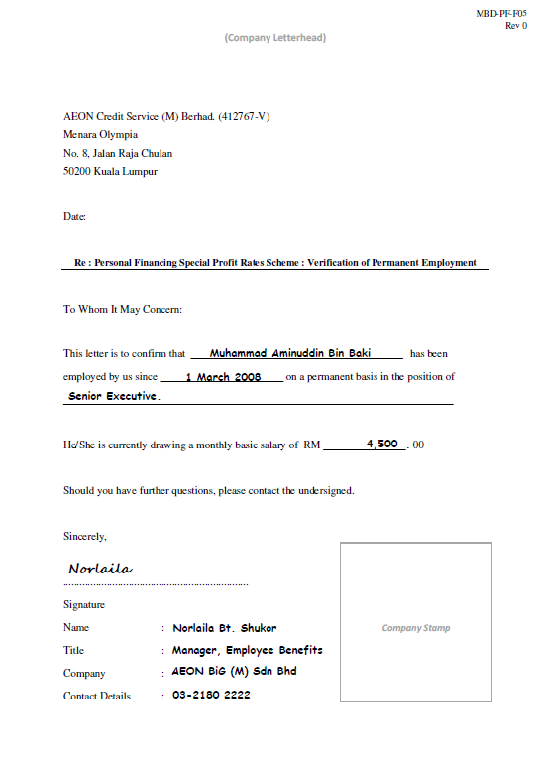
Appendix B - Sample completed Verification of Permanent Employment Letter.
Verification of Permanent Employment Letter MUST BE printed on the Company Letterhead
This part is to be signed, completed and stamped by HR Department.

Slide 24
Thank you.

